Slide 1
Wastewater Regionalization Preliminary Engineering Study
Presented by: Tanya Miller, PE
Joe Munson, PE
Banner Associates
For the communities of
Harrisburg, Tea, and Worthing, SD
April 4, 2016

Slide 2
Communities Share a Common Problem
Each is outgrowing their wastewater treatment system and considering
Expansion of their own system
Regionalization with Sioux Falls
Another option to consider
Regionalization with other communities

Slide 3
Projected Wastewater Flows
Year | TEA |  | HARRISBURG |  | WORTHING |  | RURAL LINCOLN COUNTY |  | REGIONAL TOTAL
 | Pop. | Flow (gal/day) | Pop. | Flow (gal/day) | Pop. | Flow (gal/day) | Pop. | Flow (gal/day) | Average Day Flow (gal/day) | Peak Day Flow (gal/day)
2015 | 4,888 | 586,560 | 4,908 | 490,800 | 1,000 | 100,000 | 1,000 | 100,000 | 1,277,360 | 1,916,004
2020 | 6,359 | 763,080 | 5,971 | 597,100 | 1,217 | 121,700 | 1,338 | 133,800 | 1,615,680 | 2,423,508
2025 | 8,106 | 972,720 | 7,265 | 726,500 | 1,480 | 148,000 | 1,791 | 179,100 | 2,026,320 | 3,039,446
2030 | 9,874 | 1,184,880 | 8,839 | 883,900 | 1,801 | 180,100 | 2,397 | 239,700 | 2,488,580 | 3,732,735
2035 | 11,642 | 1,397,040 | 10,767 | 1,076,700 | 2,191 | 219,100 | 3,207 | 320,700 | 3,013,540 | 4,520,367
2040 | 13,400 | 1,608,000 | 13,100 | 1,310,000 | 2,666 | 266,600 | 4,292 | 429,200 | 3,613,800 | 5,420,543

Slide 4
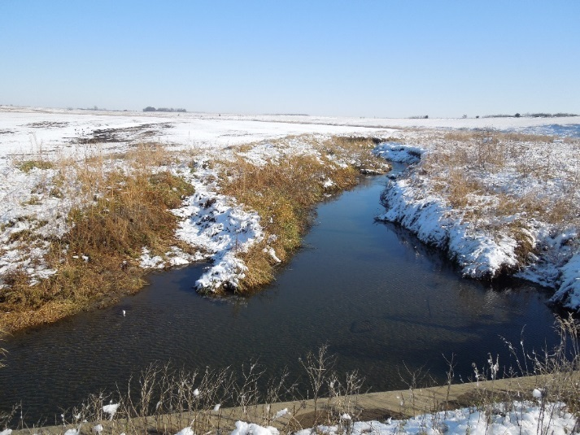
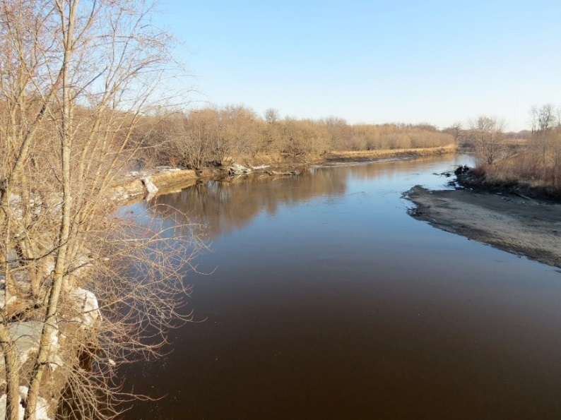
Treatment Alternatives Considered
Wastewater Plant near Worthing
Discharging to the Beaver Creek
Activated Sludge Process
Wastewater Plant east of Harrisburg
Discharging to the Big Sioux River
Sequencing Batch Reactor

Slide 5
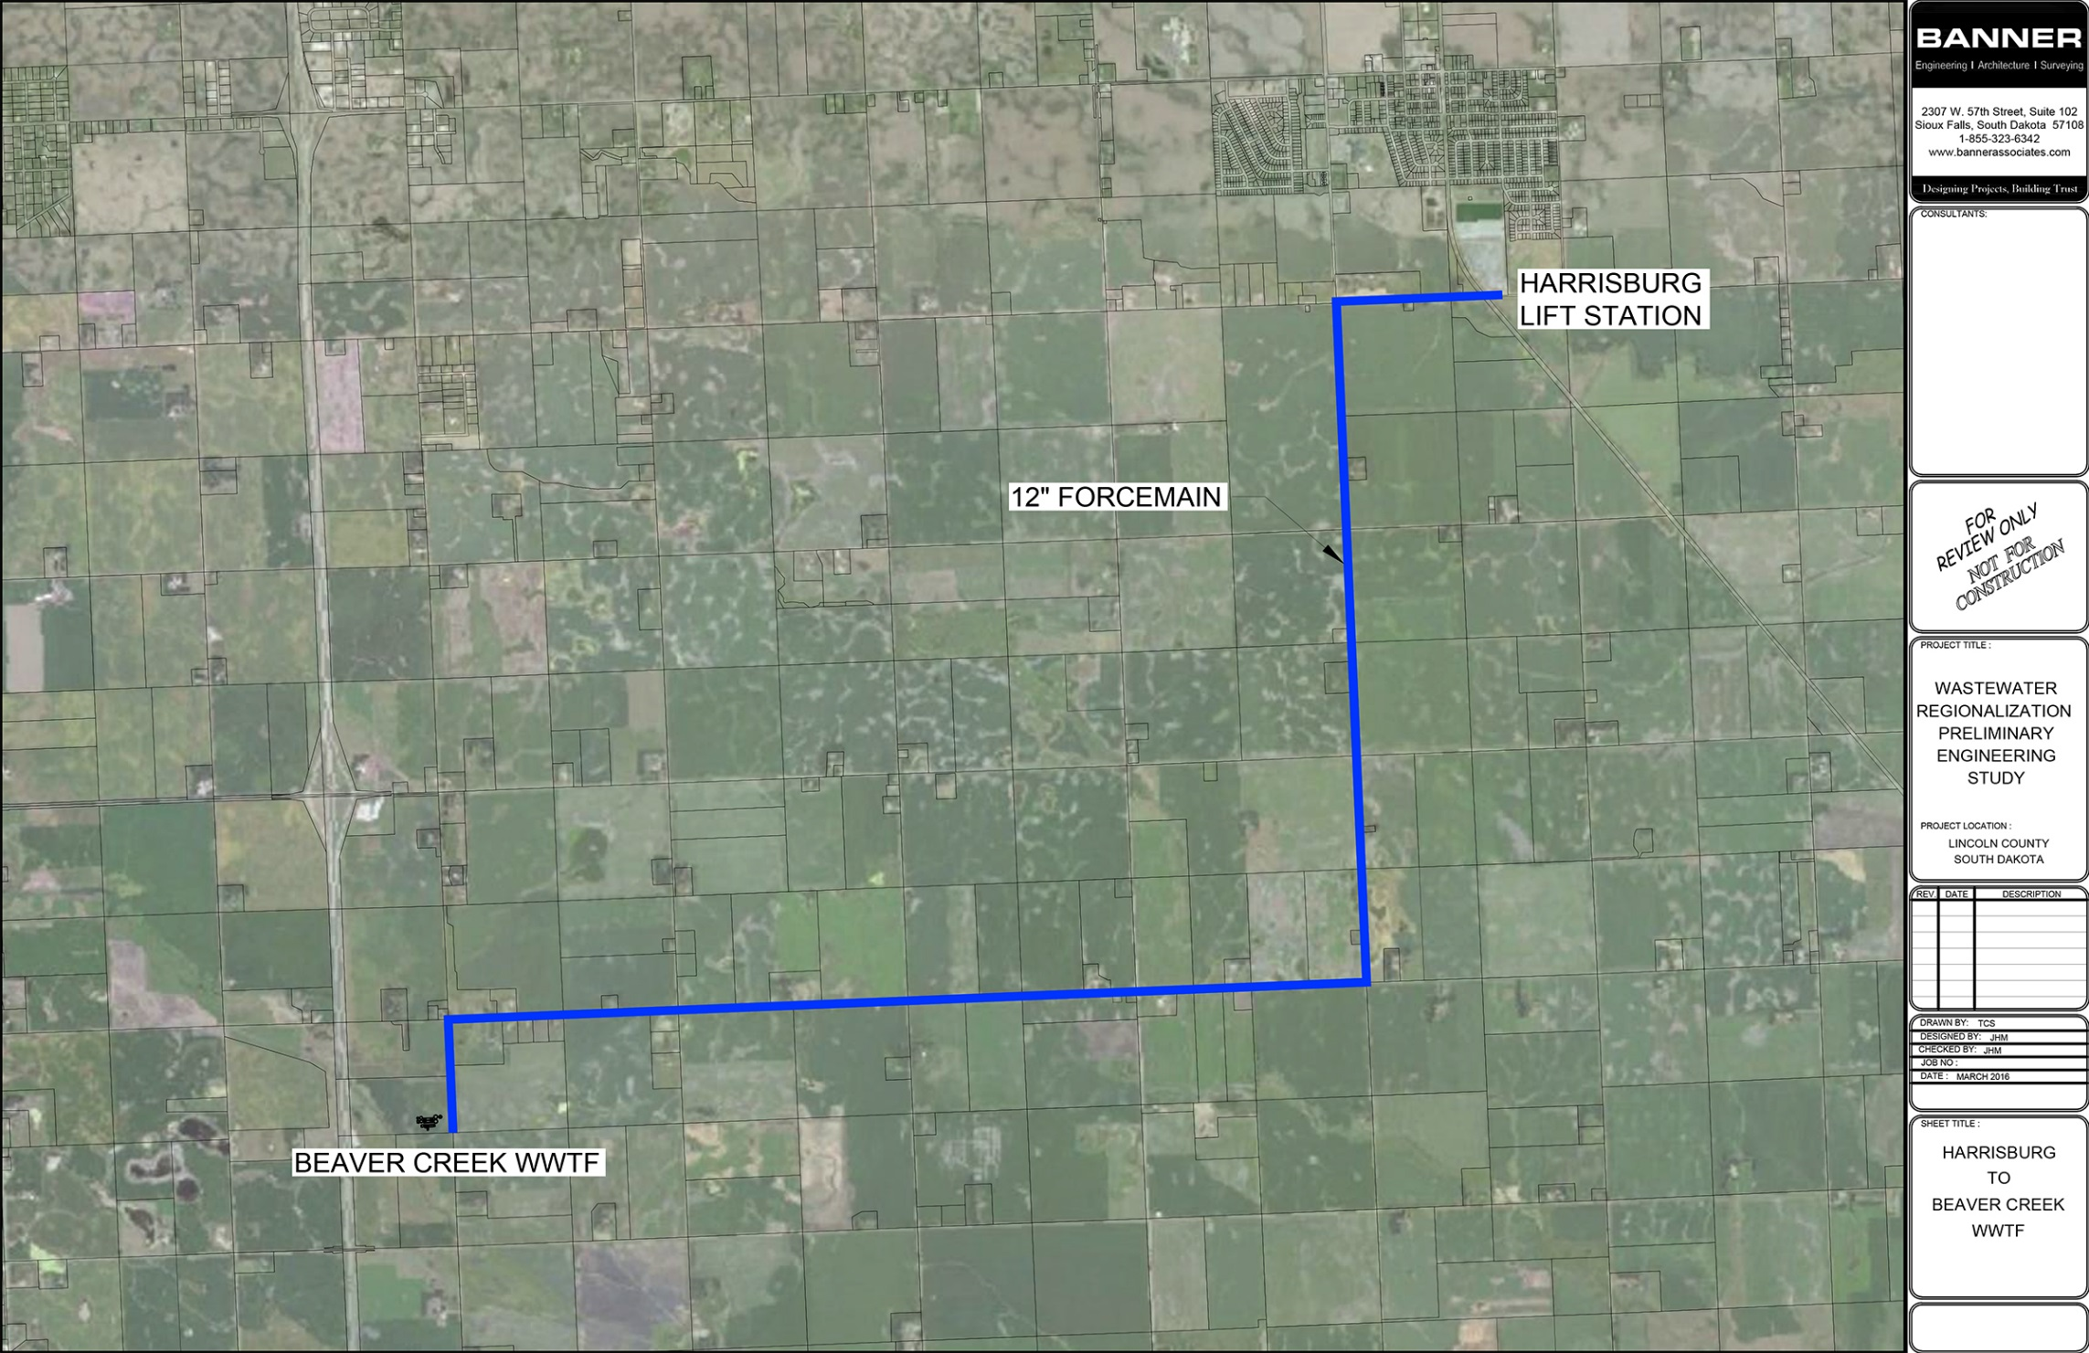
Pipeline Alternatives Considered

Slide 6
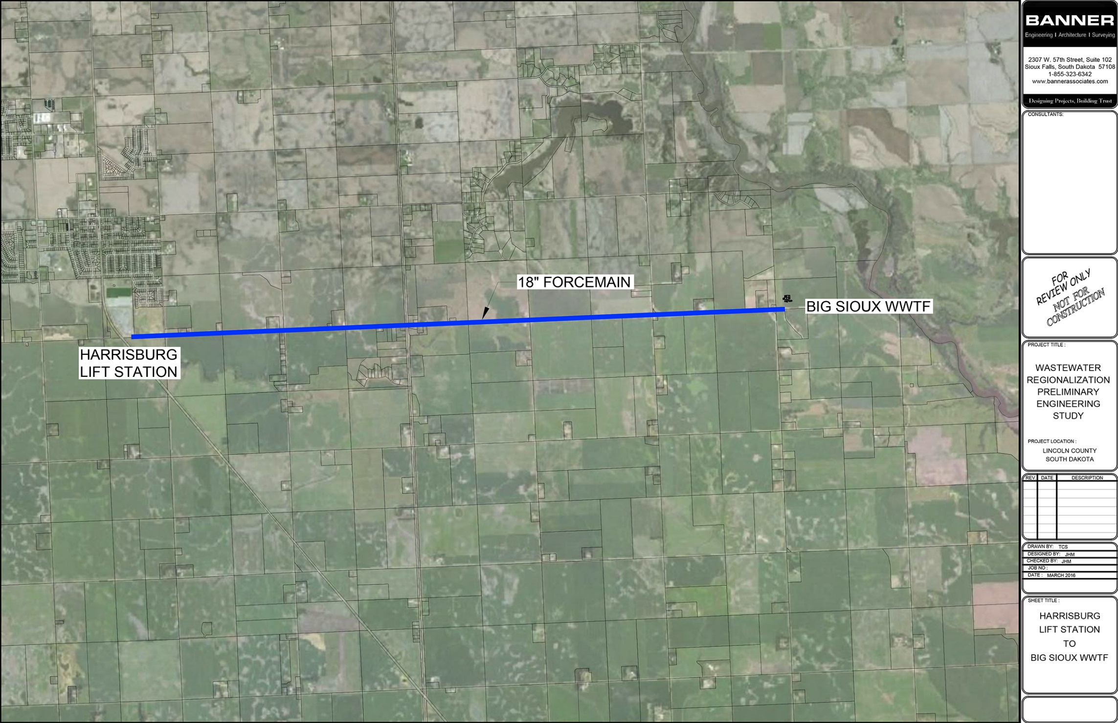
Pipeline Alternatives Considered

Slide 7
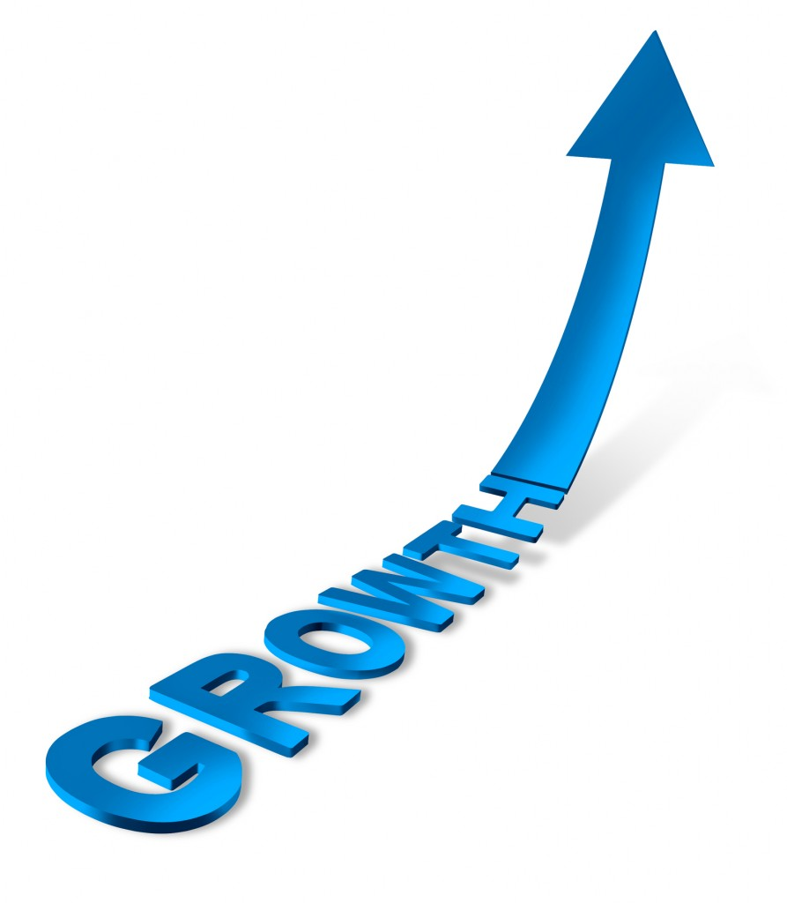
Phasing for Treatment Alternatives
Build plant to meet projected 2040 needs
Construct in two phases due to the significant population increase that is projected
Phase I - Construct to meet 2030 needs
Phase II - Plant expansion to meet 2040 needs
Add treatment to meet anticipated nitrogen and phosphorus limits.

Slide 8
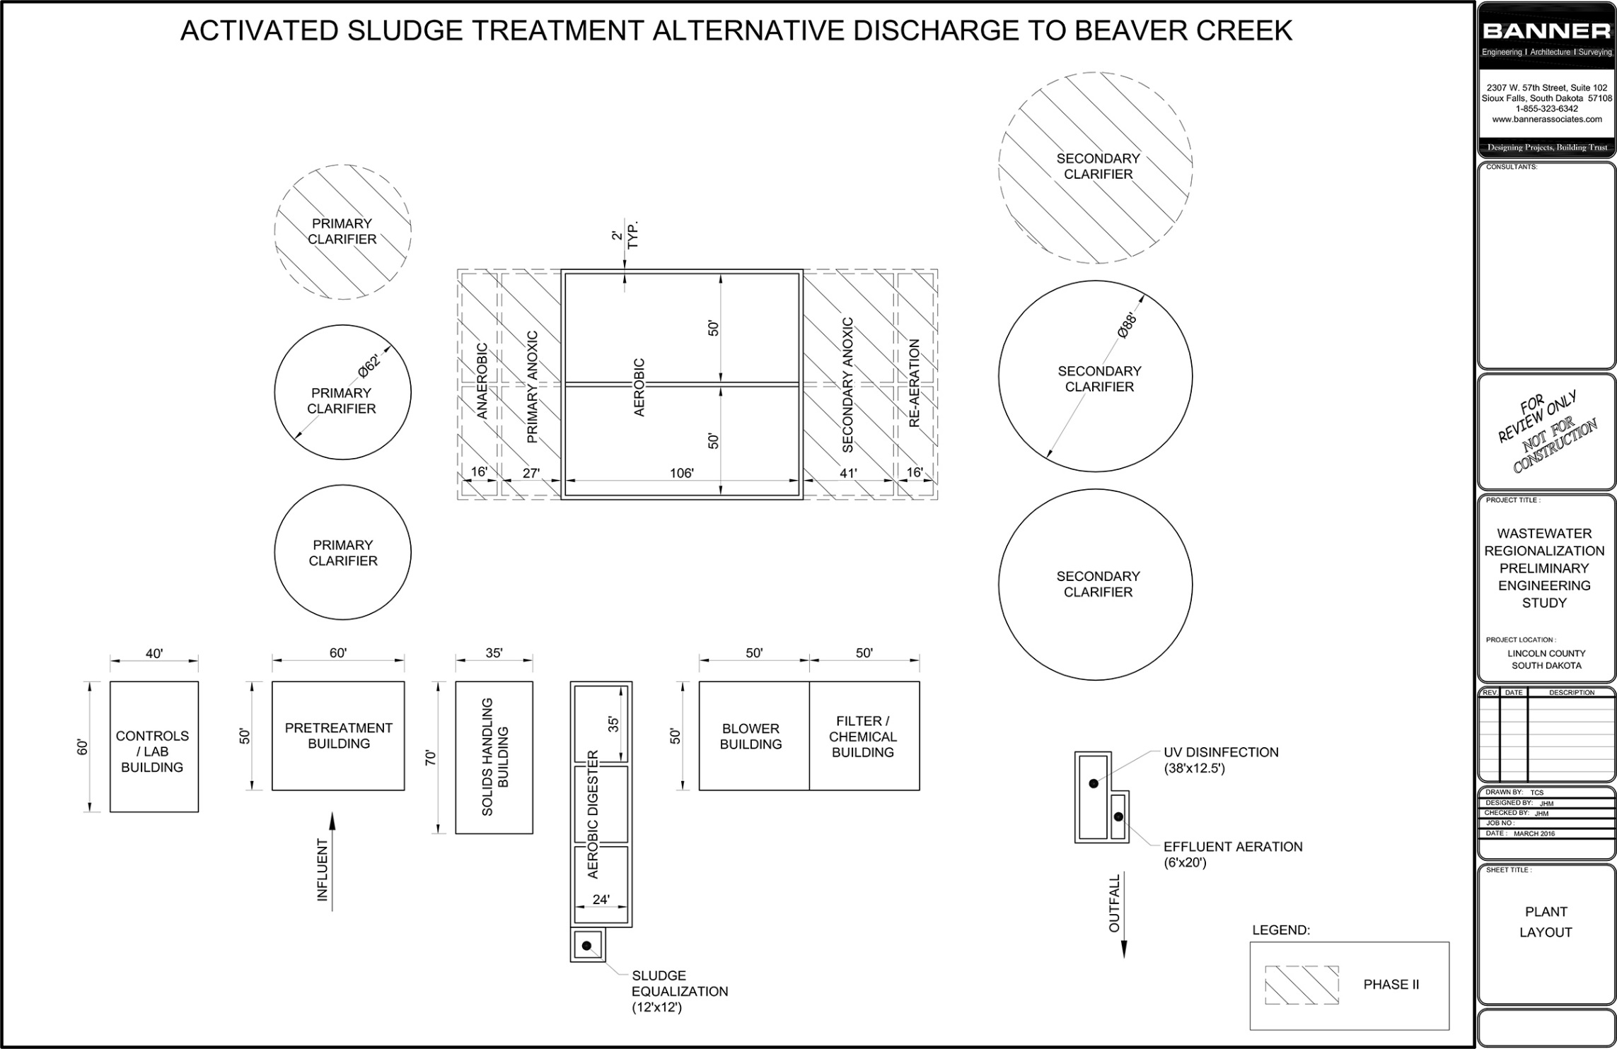
Treatment Exhibit

Slide 9
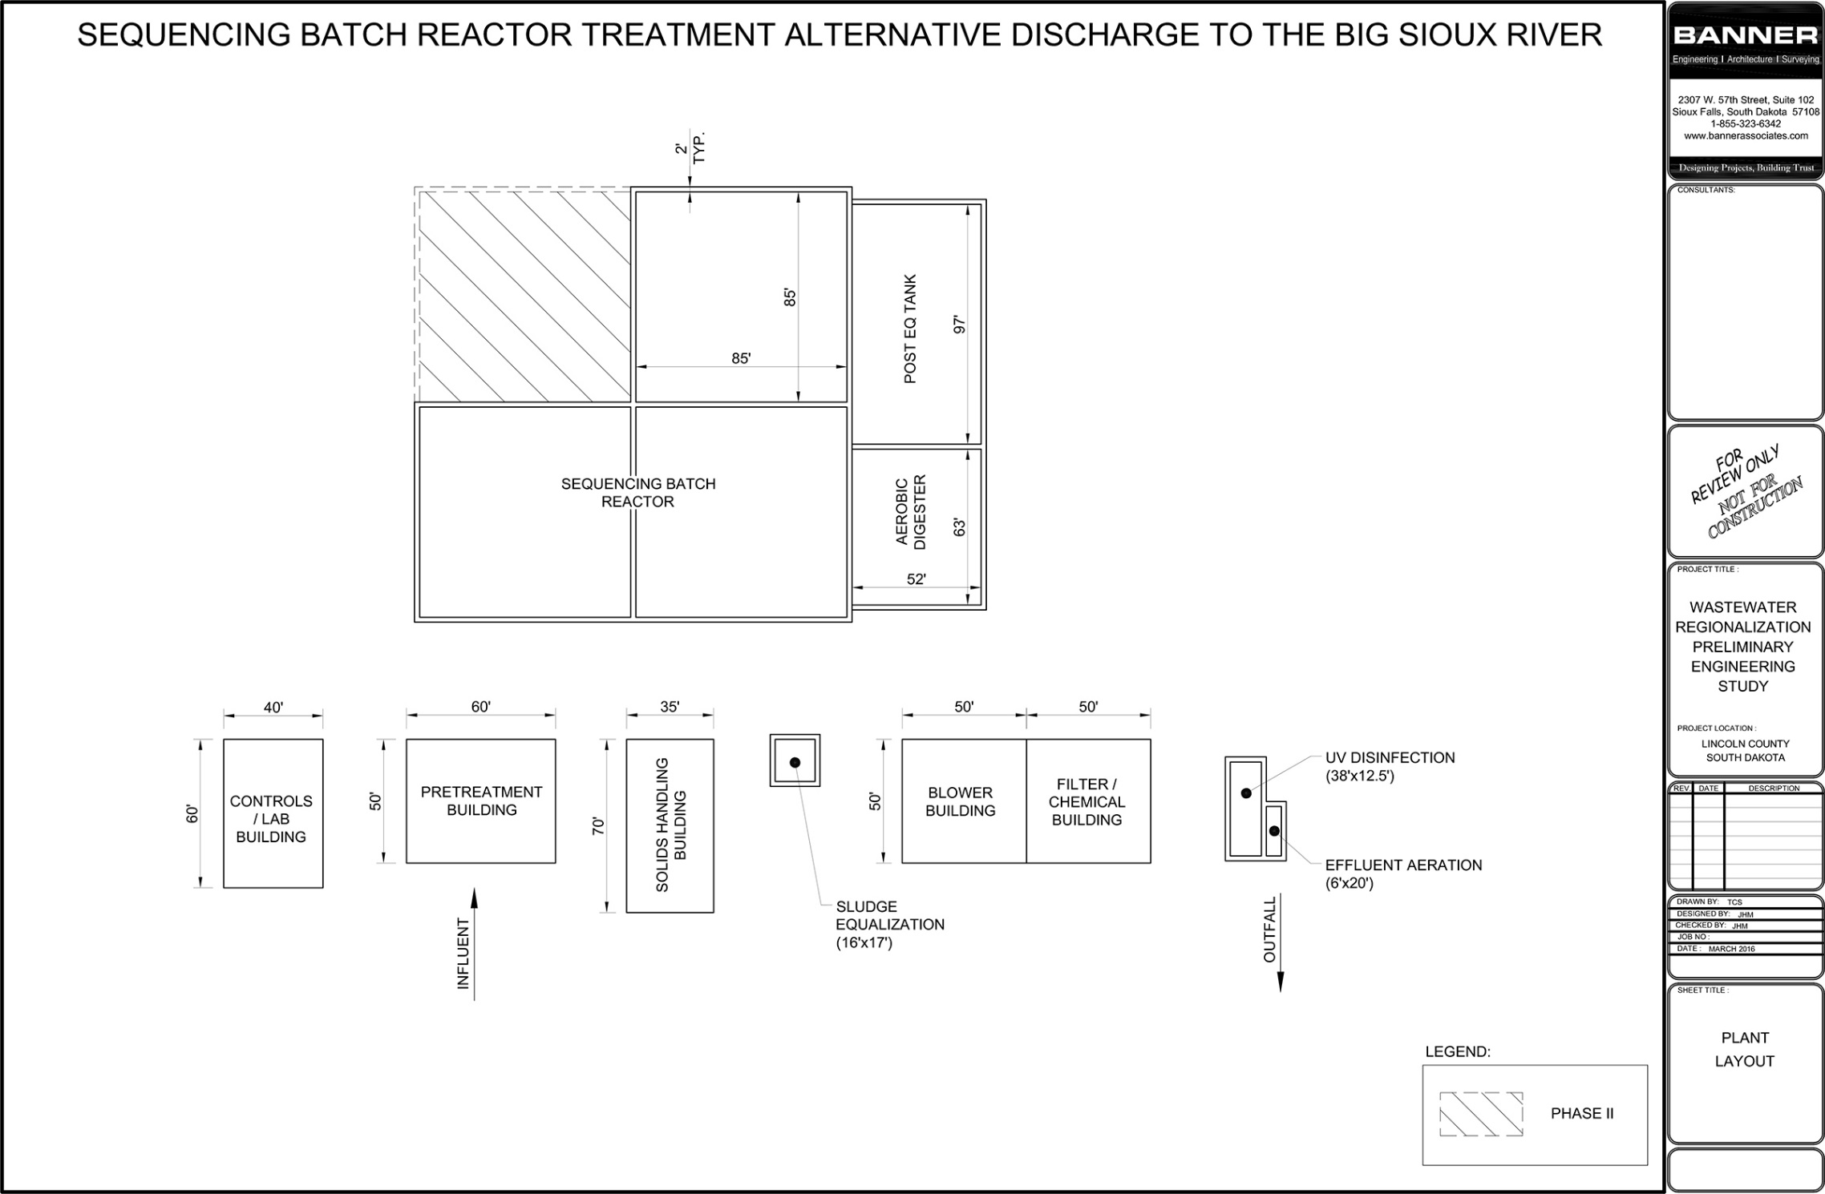
Treatment Exhibit

Slide 10
Capital Cost for Regional Wastewater
 | SBR Phase I & II | SBR - No Phasing | Activated Sludge Phase I & II | Activated Sludge No Phasing
Treatment Plant Costs | $ 29,819,100 | $ 30,238,800 | $ 39,802,400 | $ 36,085,400
Force Main/ Outfall Costs | $ 22,316,600 | $ 22,316,600 | $ 16,575,300 | $ 16,575,300
Total Construction Costs | $ 52,135,700 | $ 52,555,400 | $ 56,377,700 | $ 52,660,700

Slide 11
Are the WWTP costs realistic?
 | Peak Capacity (MGD) |  | Cost Adjusted to 2016 per ENR Index | Treatment Plant Construction Cost per Gallon
Regional WWTP Alternatives
SBR Phase I&II | 5.40 | $ 29,819,100 |  | $ 5.52
SBR - No Phasing | 5.40 | $ 30,238,800 |  | $ 5.60
Activated Sludge - Phase I&II | 5.40 | $ 39,802,400 |  | $ 7.37
Activated Sludge - No Phasing | 5.40 | $ 36,085,400 |  | $ 6.68
Lennox WWTP | 0.67 | $ 3,928,572 |  | $ 5.86
CostWorks Packaged WWTP | 5.00 | $ 30,750,000 |  | $ 6.15

Slide 12
Intent of Study
Scope included comparing:
Cost of regional wastewater plant
Cost of regionalization with Sioux Falls
Cost of recommended treatment alternative in each community’s report

Slide 13
Sioux Falls Regionalization | Volume Charge
Base charge = $15.60 per month
Volume charge of $4.01 per 1,000 gallons
Equalization credit = $0.44 per 1,000 gallons for 30 days of available storage
Treatment credit of $0.55 per 1,000 gallons
Rates and treatment credits were assumed to increase 3% annually to account for inflation.
$

Slide 14
Sioux Falls Regionalization | SDC
WATER METER SIZE (INCH) | REGIONAL WASTEWATER SYSTEM DEVELOPMENT CHARGE (PER METER)
5/8” to 3/4” | $ 2,391
1” | $ 5,978
1 ½” | $ 11,954
2” | $ 19,127
3” | $ 35,863
4” | $ 60,000

Slide 15
Sioux Falls Regionalization | Cost to Connect
WATER METER SIZE (INCH) | CITY OF HARRISBURG, SD |  | CITY OF TEA, SD |  | CITY OF WORTHING, SD
 | NUMBER OF METERS | SYSTEM DEVELOPMENT CHARGES | NUMBER OF METERS | SYSTEM DEVELOPMENT CHARGES | NUMBER OF METERS | SYSTEM DEVELOPMENT CHARGES
5/8” to 3/4” | 1,714 | $4,098,174 | 1,374 | $3,285,234 | 348 | $832,068
1” | 29 | $173,362 | 30 | $179,340 | 0 | $0
1 ½” | 11 | $131,494 | 53 | $633,562 | 0 | $0
2” | 21 | $401,667 | 10 | $191,270 | 2 | $38,254
3” | 3 | $107,589 | 2 | $71,726 | 0 | $0
4” | 1 | $60,000 | 7 | $420,000 | 0 | $0
Totals | 1,779 | $4,972,286 | 1,476 | $4,781,132 | 350 | $870,322
Additional Force Main Cost for Sioux Falls Connection/Extension |  | $3,736,736 |  | $6,530,879 |  | $4,721,500
Total Cost for Communities to Connect is $25.6 Million

Slide 16
Recommended Alternatives in Prior Studies
Water/Wastewater Master Plan Update
Regionalization with Sioux Falls
Lowest capital cost at $10.18 million (March 2014)
Wastewater Facilities Plan
Total Retention
Lowest capital cost at $11.040 million (Dec. 2014) for a population of 10,353
Wastewater
Facility Plan
Expansion of lagoons
Lowest capital cost at $0.934 million (Jan. 2006)

Slide 17
Challenges Comparing Costs
Tea study didn’t include annual SDC costs in
Sioux Falls regionalization option
Report indicated that cost would be paid by developers
Difficult to determine design flows from the Harrisburg Study
Difficult to compare mechanical plant against lagoon system
Mechanical plant achieves a much higher level of treatment

Slide 18
Comparison of Capital Construction Costs

Slide 19
What can we compare?
Present worth Analysis Comparing
Capital construction costs and O&M cost over 25 year planning period
Regional treatment plant serving area communities from this study
Regionalization with the City of Sioux Falls

Slide 20
Present Worth Comparison

Slide 21
Annual Cost | Harrisburg
20-Year on Equipment and 30-Year on Structures, Low Interest Loan

Slide 22
Summary
Regionalization with area communities is a viable solution for wastewater treatment
It is more cost effective than regionalization with Sioux Falls
It will likely be more cost effective for Tea and Harrisburg
It may be cost effective for Worthing, depending on the WWTP location

Slide 23
Recommendations
Further discussion on regionalization with area communities
Further study to review full cost of communities treating wastewater on their own
Include life cycle analysis with O&M costs
Compare alternatives on a present worth basis

Slide 24
Thank you for your time
We welcome any questions you have

Slide 25
Annual Cost per Customer | Harrisburg

Slide 26
Annual Cost per Customer | Tea

Slide 27
Annual Cost per Customer | Worthing

Slide 28
How can we compare costs from community’s prior studies?
Capital construction costs per gallon of capacity
Recommended alternative and mechanical treatment alternative from each community’s study
Regional treatment plant from this study

Slide 29
Comparison of Capital Construction Costs per Gallon of Capacity Provided

Slide 30
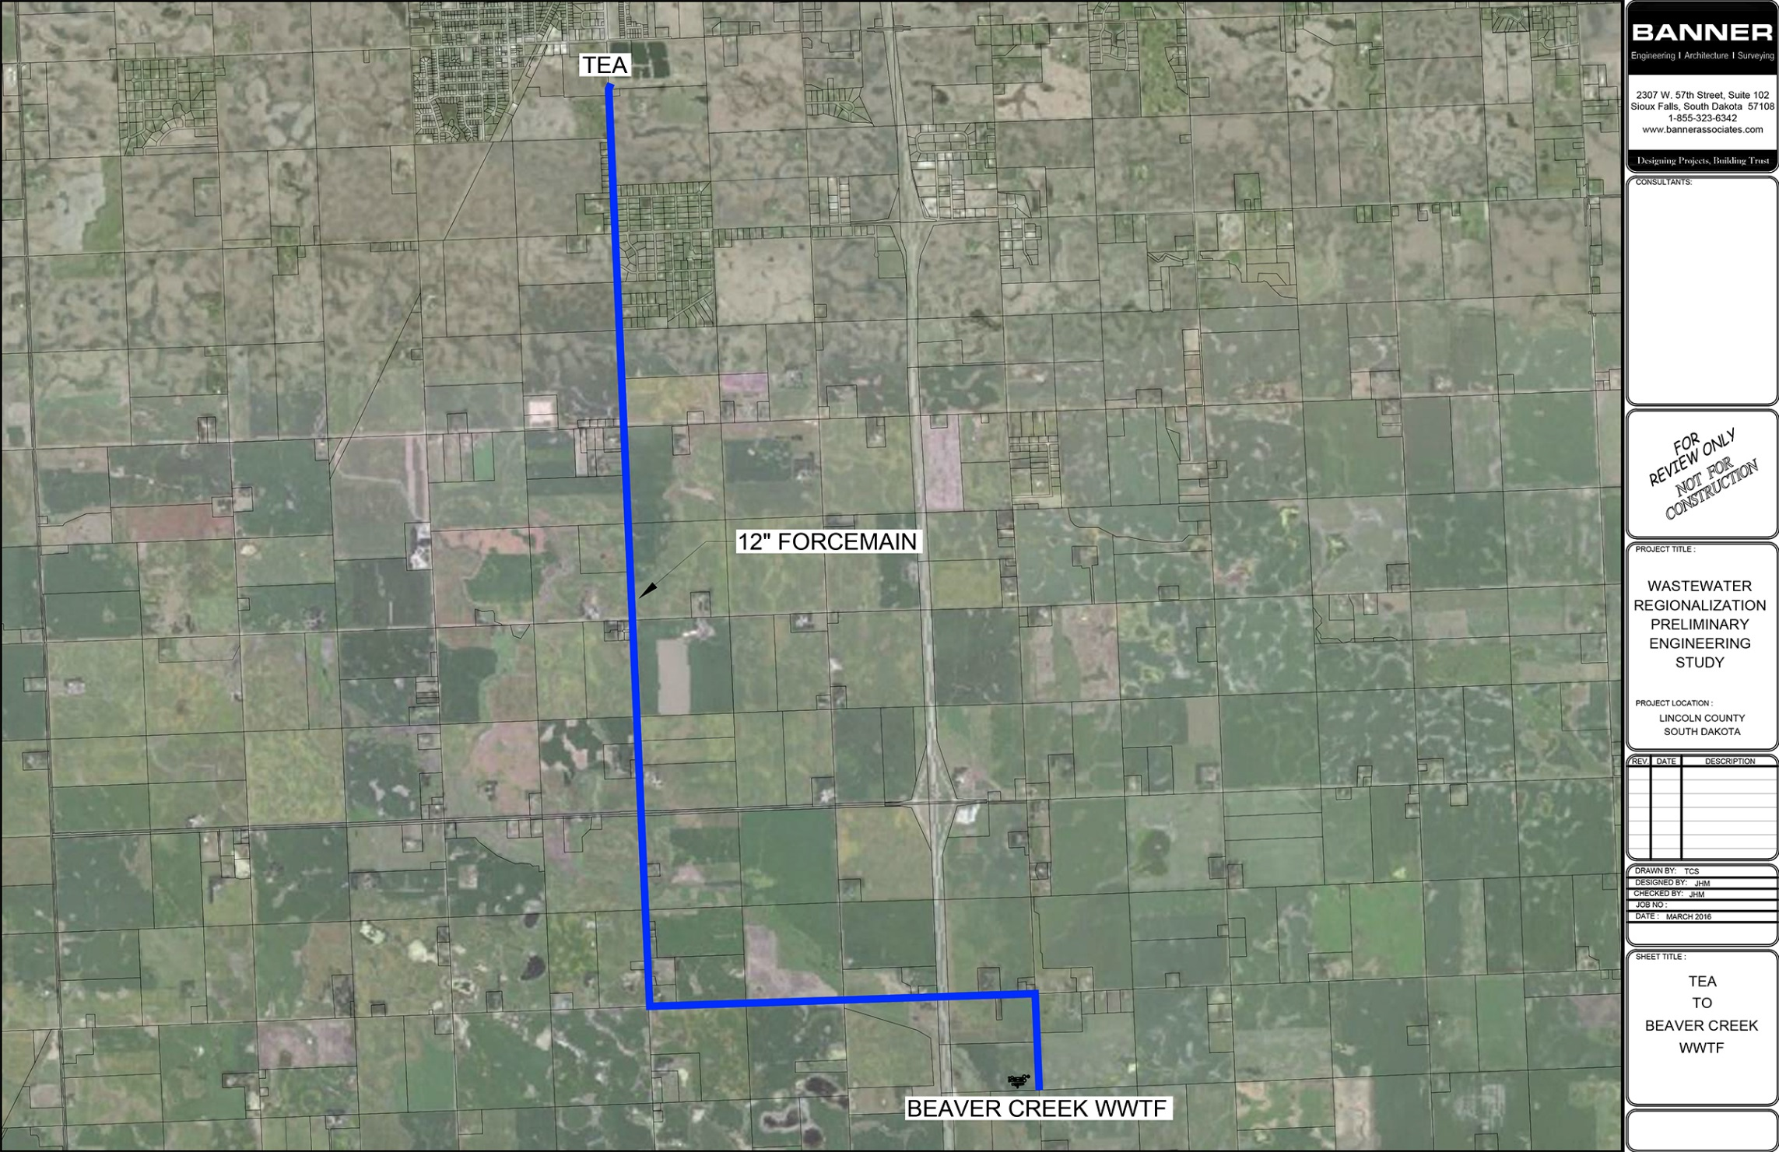
Pipeline Alternatives Considered

Slide 31
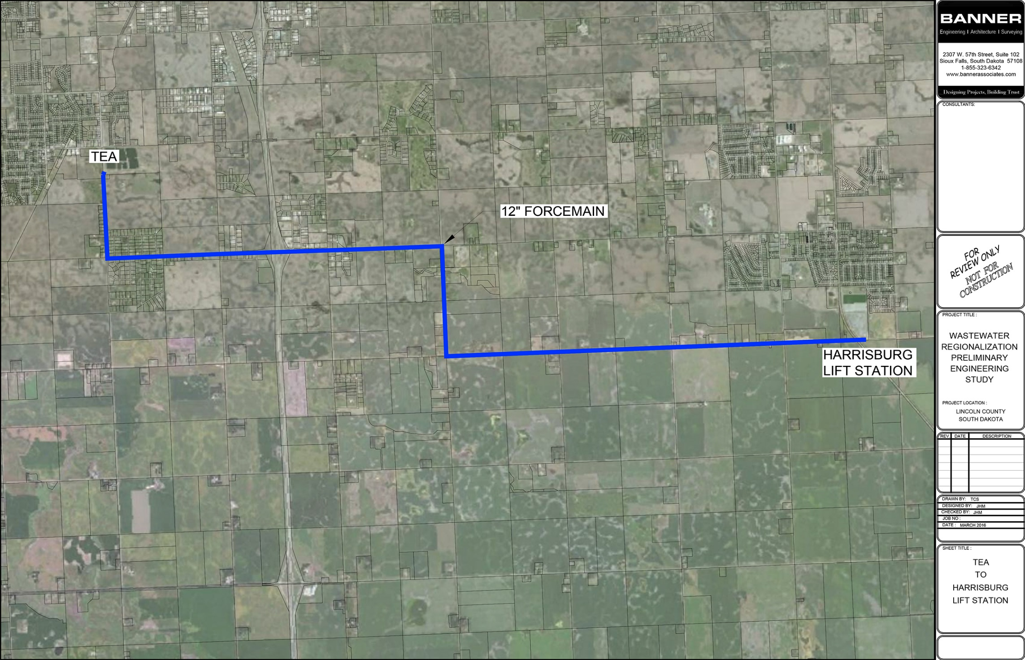
Pipeline Alternatives Considered

Slide 32
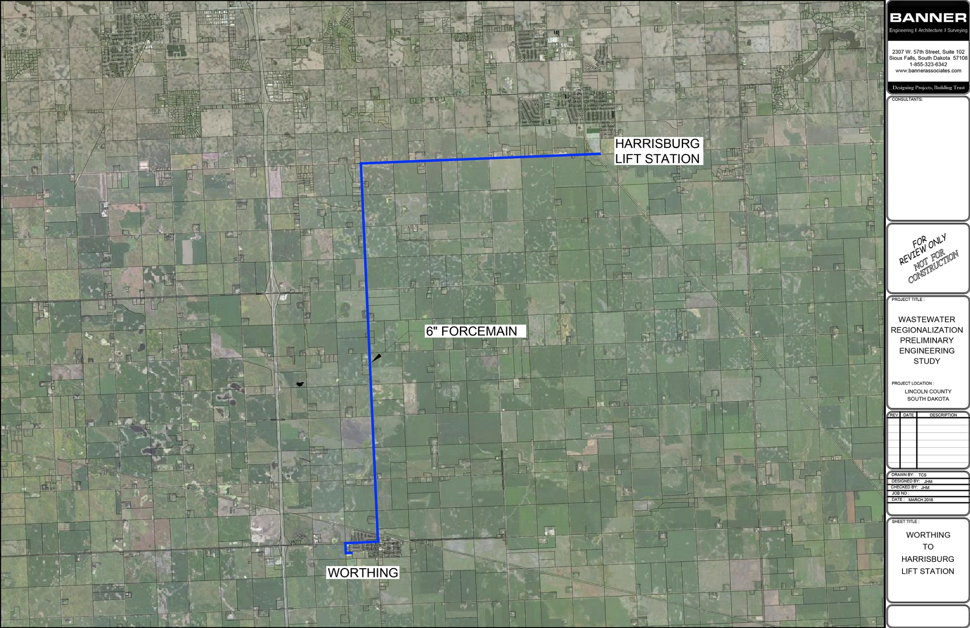
Pipeline Alternatives Considered

Slide 33
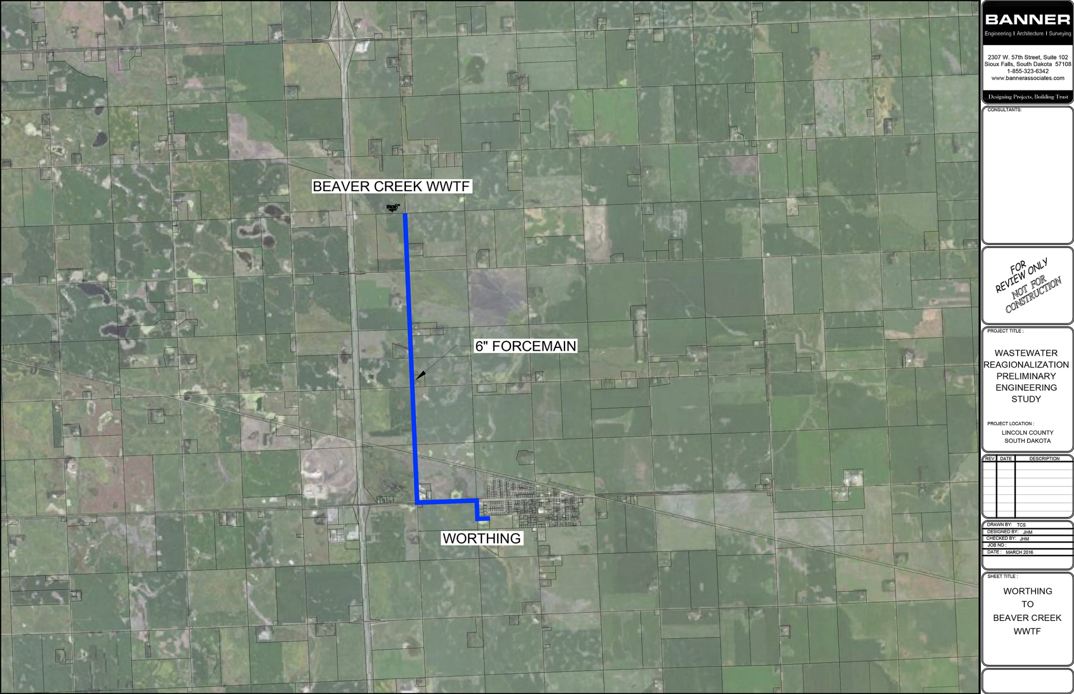
Pipeline Alternatives Considered

Slide 34
Sioux Falls Regionalization | Annual Costs
Assumes a 3% annual increase in rates.

Slide 35
Annual Cost | Tea
20-Year on Equipment and 30-Year on Structures, Low Interest Loan

Slide 36
Annual Cost | Worthing
20-Year on Equipment and 30-Year on Structures, Low Interest Loan

